Slide 1
Stored Procedures and Functions
Lecturer: Ngo Huy Bien
Software Engineering Department
Faculty of Information Technology
VNUHCM - University of Science
Ho Chi Minh City, Vietnam
nhbien@fit.hcmus.edu.vn

Slide 2

Objectives

Slide 3

Contents

Slide 4

References
Adam Jorgensen et al. (2012). Microsoft SQL Server 2012 Bible. Wiley.

Slide 5
Stored Procedures
Stored procedures are a way to store and reuse T-SQL code within the SQL Server Database Engine.
The procedure is stored as an object within SQL Server, and when created, can be modified and executed with simple T-SQL commands.

Slide 6
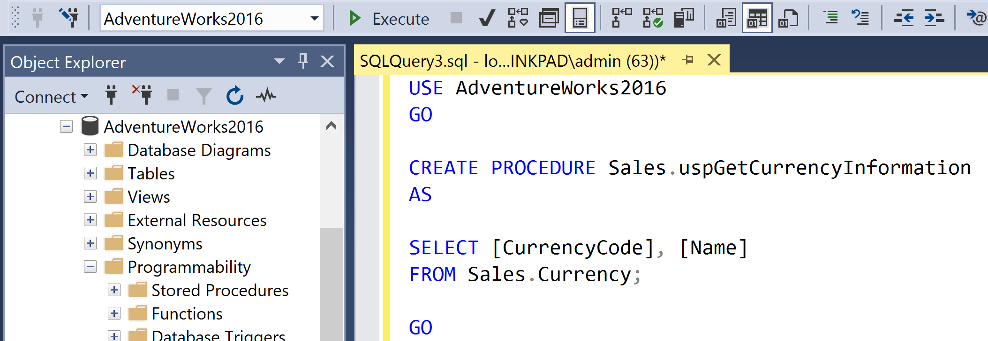
1. Create Stored Procedure
USE AdventureWorks2016
GO
CREATE PROCEDURE Sales.uspGetCurrencyInformation
AS
SELECT [CurrencyCode], [Name]
FROM Sales.Currency;
GO

Slide 7
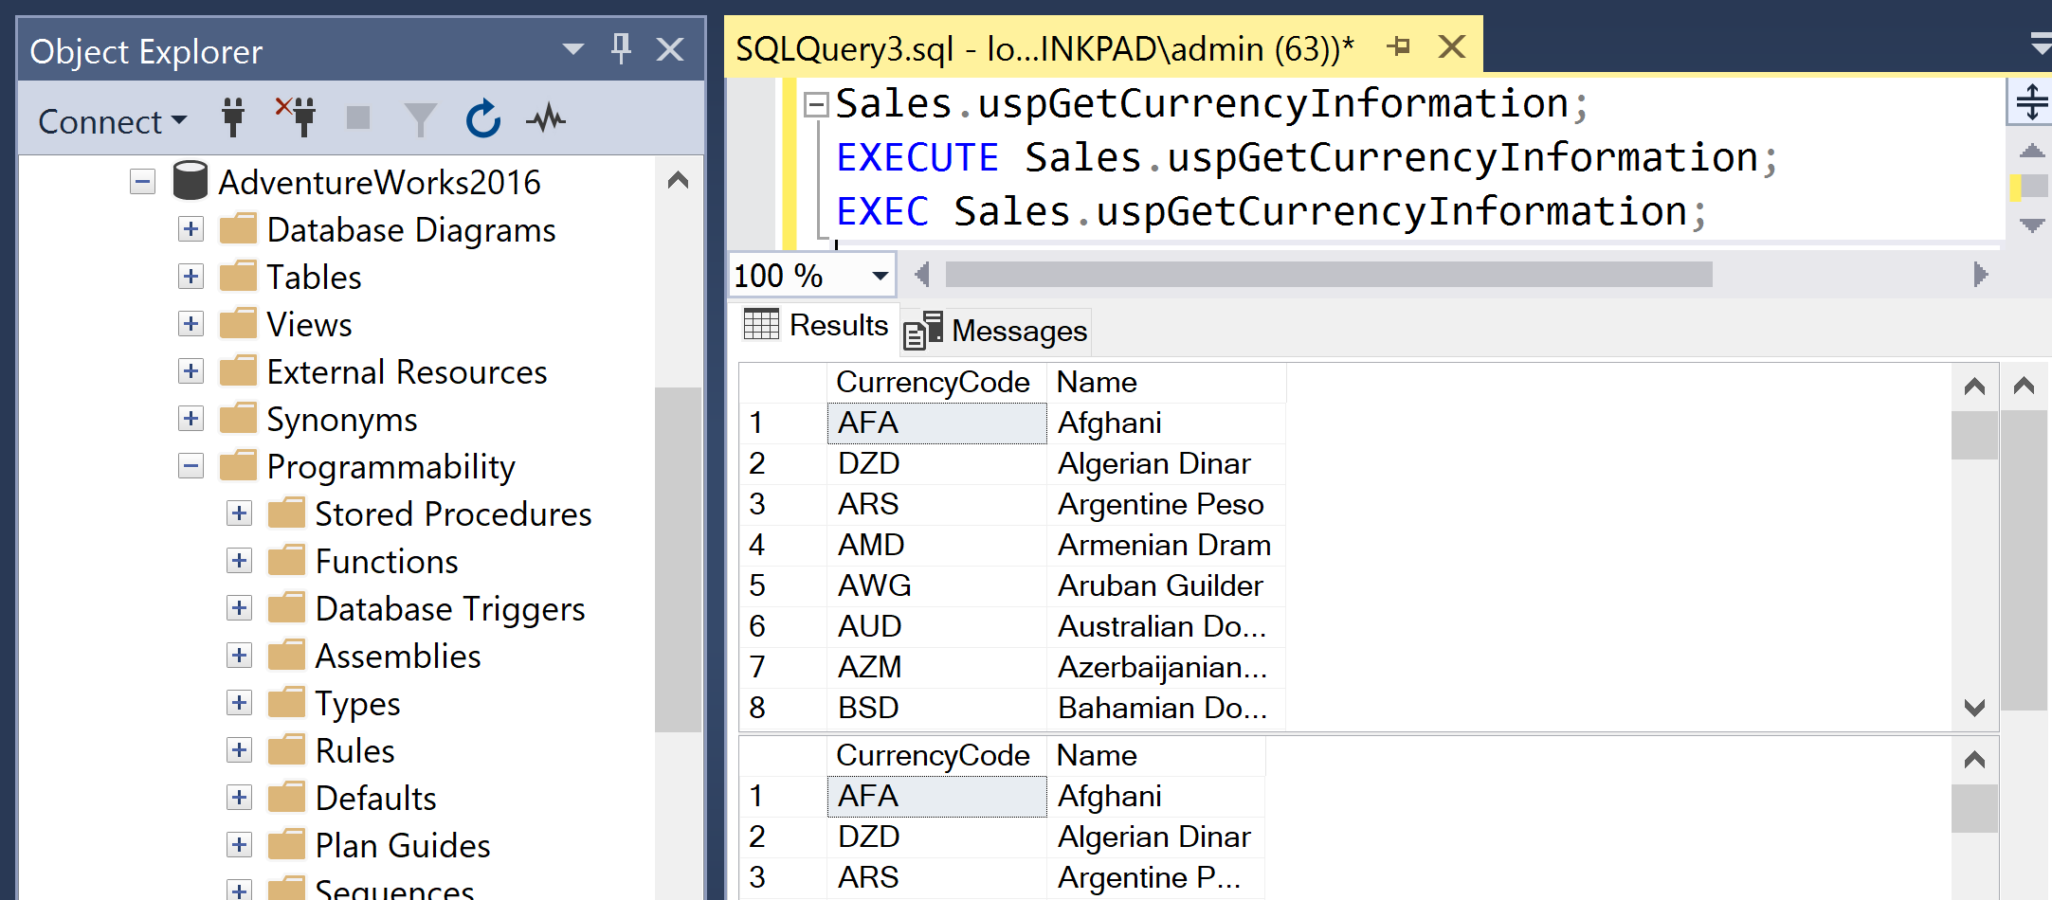
2. Execute Stored Procedure
Sales.uspGetCurrencyInformation;
EXECUTE Sales.uspGetCurrencyInformation;
EXEC Sales.uspGetCurrencyInformation;

Slide 8
3. Create SP with Input Parameters
USE AdventureWorks2016
GO
DROP PROCEDURE [Sales].[uspGetCurrencyInformation]
GO
CREATE PROCEDURE [Sales].[uspGetCurrencyInformation]
@CurrencyCode char(3)
AS
SELECT CurrencyCode, Name
FROM Sales.Currency
WHERE CurrencyCode = @CurrencyCode;
GO
EXECUTE Sales.uspGetCurrencyInformation @CurrencyCode = 'USD';
GO

Slide 9
Why Stored Procedures?
Consistency: A stored procedure encapsulates one or more T-SQL statements, enabling it to be executed consistently across different areas of a system.
Maintainability: Stored procedures are maintainable because they are modular and independent of the application or tool that they’re called from. Complex logic within a stored procedure can be modified with little to no impact on the application that calls it.
Security: From a database perspective, the stored procedure is an object. This means that the ability to execute the procedure can be granted to specific users or groups. From an application perspective, stored procedures provide an opportunity to validate input to a T-SQL process before it is executed.
Performance: Stored procedure execution is a server-side process. This means that no matter how complex the procedure, only one statement is sent over the network.

Slide 10


Slide 11
User-Defined Functions [1]
A UDF is a routine that accepts parameters, performs an action, and returns the result of that action.
The result is either a scalar (single) value or a table.
They can be used within the FROM clause of a SELECT statement or an expression.

Slide 12
Scalar Functions
Scalar functions return a single value.
They are commonly used in expressions within the SELECT, WHERE, ORDER BY, GROUP, and HAVING clauses, or T-SQL code.
Using a function in a WHERE condition forces the function to be calculated for every row.

Slide 13
User Information Functions
SELECT
USER_NAME() AS 'User',
SUSER_SNAME() AS 'Login',
HOST_NAME() AS 'Workstation',
APP_NAME() AS 'Application';

Slide 14
Date and Time Functions
SELECT GETDATE() AS 'DateTime'
SELECT CURRENT_TIMESTAMP AS 'DateTime' -- The same as GETDATE() except ANSI standard.
SELECT DATENAME(YEAR, CURRENT_TIMESTAMP) AS 'Year';
SELECT DATENAME(MONTH, CURRENT_TIMESTAMP) as 'Month',
DATENAME(WEEKDAY, CURRENT_TIMESTAMP) As 'Day'

Slide 15
STUFF
STUFF (string, insertion position, delete count, string inserted)
The STUFF() function inserts one string into another string.
The inserted string may delete a specified number of characters as it is inserted:
SELECT STUFF('abcdefg', 3, 2, '123');

Slide 16
Using the SOUNDEX() Function
The purpose of Soundex is to sort similar-sounding names together, which is very useful for dealing with contact information in a database application.
For example, if I call a phone bank and give them my name (Nielsen), they invariably spell it ‘‘Nelson’’ in the contact lookup form, but if the database uses Soundex properly, then I’ll still be in the search-result list box.
SELECT LastName, FirstName
FROM dbo.Customer
WHERE SOUNDEX('Nikolsen') = SOUNDEX(LastName);

Slide 17
Functions vs. Stored Procedures

Slide 19
Dynamic SQL
The EXECUTE command, or EXEC for short, creates a new instance of the batch as if it were a batch submitted from some client to the server.
While the EXECUTE command is normally used to call a stored procedure, it can also be used to execute a T-SQL query or batch.
Issues:
Dynamic SQL that includes user entries in WHERE clauses can be open to SQL injection attacks.
Poorly written dynamic SQL queries often include extra table references and perform poorly.
T-SQL code that generates T-SQL code can be tricky to debug.

Slide 20
Notes
You cannot execute a command with exec or sp_executesql nor can execute a stored procedure in a function.

Slide 21
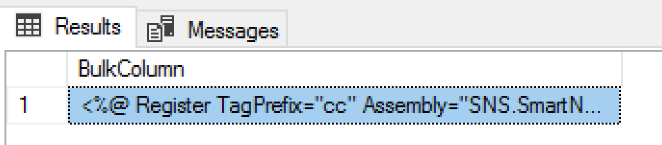
Read File Data
https://docs.microsoft.com/en-us/sql/t-sql/functions/openrowset-transact-sql
Uses the BULK rowset provider for OPENROWSET to read data from a file.
SELECT BulkColumn
FROM OPENROWSET (BULK 'C:\Users\MED1DBBCAdmin\Downloads\SkinFile.skin', SINGLE_CLOB) SkinFile

Slide 22
Dynamically Read File Content (I)
CREATE PROCEDURE [dbo].[Ut_Read_OS_FileContent]
(
@OSFilePath NVARCHAR(256)
, @FileContent NVARCHAR(MAX) OUTPUT
)
AS
BEGIN
DECLARE @sql NVARCHAR(MAX)
, @parmsdeclare NVARCHAR(4000)
SET @sql = 'select @FileContent=(select * from openrowset (
bulk ''' + @OSFilePath + '''
,SINGLE_CLOB) x
)'
SET @parmsdeclare = '@FileContent varchar(max) OUTPUT'
EXEC sp_executesql @stmt = @sql
, @params = @parmsdeclare
, @FileContent = @FileContent OUTPUT
END
GO

Slide 23
Dynamically Read File Content (II)
DECLARE @SkinFilePath nvarchar(256);
DECLARE @FileContent NVARCHAR(MAX);
SELECT @SkinFilePath = 'C:\Users\admin\Downloads\TestCompany1\SkinFile.skin';
EXECUTE dbo.Ut_Read_OS_FileContent @SkinFilePath, @FileContent OUTPUT;
SELECT @FileContent;

Slide 24
Determine If a File Exists
DECLARE @SkinFilePath nvarchar(256);
DECLARE @FileExists INT
SELECT @SkinFilePath = 'C:\Users\admin\Downloads\TestCompany1\SkinFile.skin';
EXEC master.dbo.xp_fileexist @SkinFilePath, @FileExists OUTPUT
SELECT @FileExists;

Slide 25
Arrays and Lists in SQL Server
http://www.sommarskog.se/arrays-in-sql.html
http://www.sommarskog.se/arrays-in-sql-2005.html
SQL 2016: string_split
Older version: add one yourself
CREATE FUNCTION intlist_to_tbl (@list nvarchar(MAX))
RETURNS @tbl TABLE (number int NOT NULL) AS
BEGIN
DECLARE @pos int,
@nextpos int,
@valuelen int
SELECT @pos = 0, @nextpos = 1
WHILE @nextpos > 0
BEGIN
SELECT @nextpos = charindex(',', @list, @pos + 1)
SELECT @valuelen = CASE WHEN @nextpos > 0
THEN @nextpos
ELSE len(@list) + 1
END - @pos - 1
INSERT @tbl (number)
VALUES (convert(int, substring(@list, @pos + 1, @valuelen)))
SELECT @pos = @nextpos
END
RETURN
END

Slide 27
Triggers
SQL Server triggers are special stored procedures attached to table events. They can’t be executed directly, but fire only in response to an INSERT, UPDATE, or DELETE event on a table.
Users can’t bypass a trigger; and unless the trigger sends a message to the client, the end user is unaware of its actions.
SQL Server has two kinds of transaction triggers: instead of triggers and after triggers.

Slide 28
Instead of Trigger
INSTEAD OF triggers execute “instead of” (as a substitute for) the submitted DML statement.
INSTEAD OF triggers are useful when the DML statement fi ring the trigger will always be rolled back and some other logic will be executed instead of the DML statement, for example:
When the DML statement attempts to update a nonupdatable view, the INSTEAD OF trigger updates the underlying tables instead.
When the DML statement attempts to directly update an inventory table, an INSTEAD OF trigger updates the inventory transaction table instead.
When deleting rows, an INSTEAD OF trigger moves them to an archive table instead.

Slide 29
Creating Triggers
CREATE TRIGGER Schema.TriggerName ON Schema.TableName
AFTER | INSTEAD OF [Insert, Update, (and or) Delete]
AS
Trigger Code;

Slide 30

Thank You & See You Again

